Slide 1

Travel Agency Inc. LTD
✈®
Ramy Gildenberg 204035901
Avi Baazov 318603271

Slide 2
The System - General Description
Old school type of agency , with a dash of digital feel
The system is used for the travel agency agent book services for the customer
Traveler can request booking from the agent and view his booking info
Booking of hotels for the customer
Booking of flights for the customer
Booking for “lucratively” priced vacation packages

Slide 3
Traveler
Can see details about pricing of all the services
Can book a hotel , flight, vacation package
can access his itinerary of the trip he is booked for
can access his plane ticket information
can access his hotel orders information
can update his personal information(first name , last name , date of birth, etc’)
can request a cancel on a booking

Slide 4
Agent
can book a hotel,flight,vacation package as requested by the traveler manually
can add or remove a traveler from the agency database
update and delete hotels , flights, vacation packages if the need arises
update the pricing
access to travel contact info
receives salary

Slide 5
Databse Entities
Traveler - the customer ,requests to book a hotel , flights ,or a vacation package.his ID number,first name , last name , phone number , gender , date of birth ,passport number,email, and trip id(if existent) is stored in the database.
Agent - does the work for the traveler if he is not able to book things on his own , plus is responsible for updating the database as needed for hotel , flights , vacation packages.
His first name , last name , employee ID,salary .
Flight - one of the options for the traveler to book , it’s data is stored in the system database,flight company name , flight number , departure date and time,the airports initials, city and country,and the same info for the return flight,flight duration and ticket prices.
Hotel - second option for the traveler to book , it’s data is also stored in the system database,the hotel’s ID, name , its star rating, the city it is based in,address,beds in room and room prices.

Slide 6
Databse Entities
Vacation packages - the third option for the traveler to book.Its ID, destination\s , departure date ,flight ID, return date, hotel name and star rating , price of the package , are stored in the database.
Trip - the trip that the traveler built for himself. Each trip has its unique trip_ID, departure date , return date , total price , destination city and country , departure city and country ,chosen hotels, all stored in the database , where the traveler can view it.

Slide 7
Relationships
The agent helps the traveler and book services for him, the traveler than have access to his trip info,whether it be a hotel,flight or vacation package.
The agent can add/remove travelers from the database, and can see his(traveler) required info.
The vacation package contains info about hotel and flights .
Hotels are located in certain cities , flights leave from certain cities and land in other cities.
Flights and hotels have a relationship with the city entity ,each flight has its departure and arrival city, while hotels are linked to city location

Slide 8
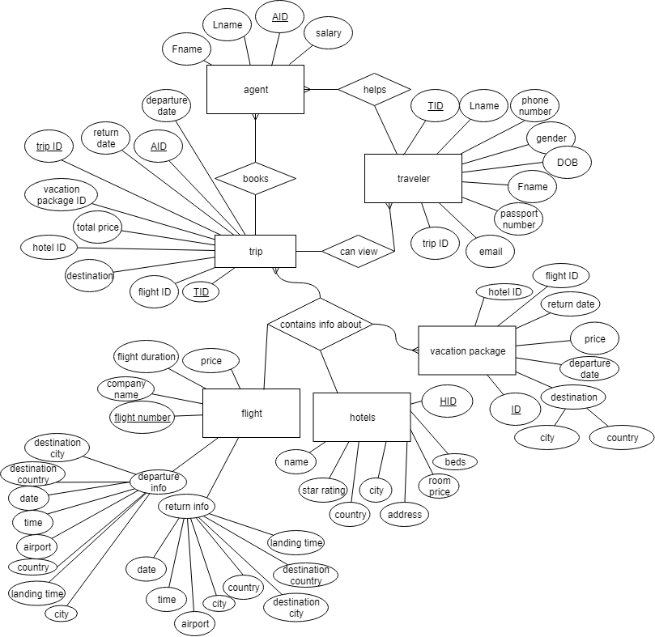

Slide 9
Queries
//display travelers identification info sorted by name
SELECT Fname,Lname,id,gender,dob FROM traveler ORDER BY Lname ASC;
//To find N highest salary
SELECT TOP 1 salary FROM
(SELECT DISTINCT TOP N salary FROM agent ORDER BY salary ASC)
//show vacation package for family(where there are more than two beds in hotel room)
SELECT vacation_package. * FROM vacation_package,hotels WHERE vacation_package.hotel_ID =hotels.ID AND hotels.beds>1

Slide 10
//display best-deal package
SELECT vacation_package. * FROM vaction_package,flight,hotel WHERE
hotel.ID=vacation_package.hotel_ID AND flight.id=vacation_package.flightl_ID AND hotel.star_rating=(SELECT MAX(hotel.star_rating)FROM hotel) AND vacation_package.payment=(SELECT MIN(vacation_package.payment )FROM vacation_package)

Slide 11
//show all the flight times and cities according to date
SELECT time,city,destination_city ,landing_time
FROM flight
WHERE date=’ 2020-01-25’
//show matches of all hotel and their address to flight destination
SELECT city,address,star_rating FROM hotel
INNER JOIN flight ON hotel.city= flight.destination_city

Slide 12
//show hotels sorted by star rating in Barcelona
SELECT name,star_rating,address,room_price
FROM hotels
WHERE star_rating BETWEEN 4 AND 5 AND city=’Barcelona’
ORDER BY star_rating DESC

Slide 13
//weather conditions that forced flight cancelation that day
DELETE FROM flight WHERE
departure_date=getDate() AND return_date=getDate()
AND return_airport=’TLV’ AND departure_airport=’TLV’

Slide 14
The End
Thanks for listening!

